Slide 1
ROLE OF INTERVENTIONAL PULMONOLOGY IN PLEURAL DISEASE
Dr Waweru Munyu

Slide 2
Interventional Pulmonology in Pleural disease
Interventional pulmonology offers minimally invasive tools to diagnose and treat pleural diseases, such as pleural effusions and pneumothorax.
Key procedures include thoracentesis for fluid removal, medical thoracoscopy for guided biopsies, indwelling pleural catheter (IPC) insertion for chronic effusions, and pleurodesis to prevent fluid or air reaccumulation.
These techniques provide faster, safer, and often more effective management of pleural conditions compared to traditional methods.

Slide 3
Available modalities
Thoracic ultrasound
Trans thoracic biopsies
Medical thoracoscopy
Pleural drains

Slide 4
Thoracic ultrasound
Currently, we have u/sound devices that fit in the pocket
Enhances access
Image quality is excellent
No need for different probes for different organs
Training on the use of the devices is easy and locally available
Online resources available
Quality image acquisition and interpretation is key for optimal use

Slide 5
Advantages
Real time – enables instant decision making
Do we need drainage now
Is it empyema
Guiding biopsy/fluid acquisition – lung, pleura, mass
Best site to access during thoracoscopy

Slide 6
Challenges
Cost of equipment
Skill training
Appropriate tools for pleura biopsy

Slide 7
Transthoracic biopsies
May be blind or image guided
Blind procedures
More useful in diffuse disease eg TB
Uses Abram’s needle
Yield may be increased by image eg US guidance esp for thichened pleura or masses

Slide 8
Image guided
May target pleural or lung lesions
Ultrasound more useful in pleural lesions
May use Abrams or Trucut needle

Slide 9
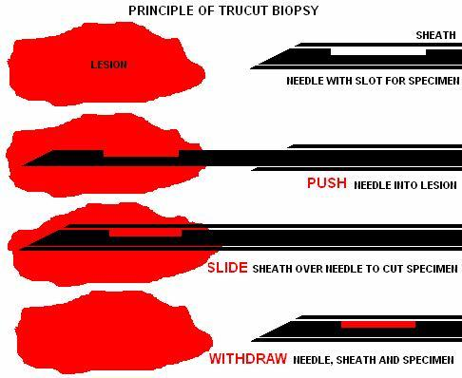
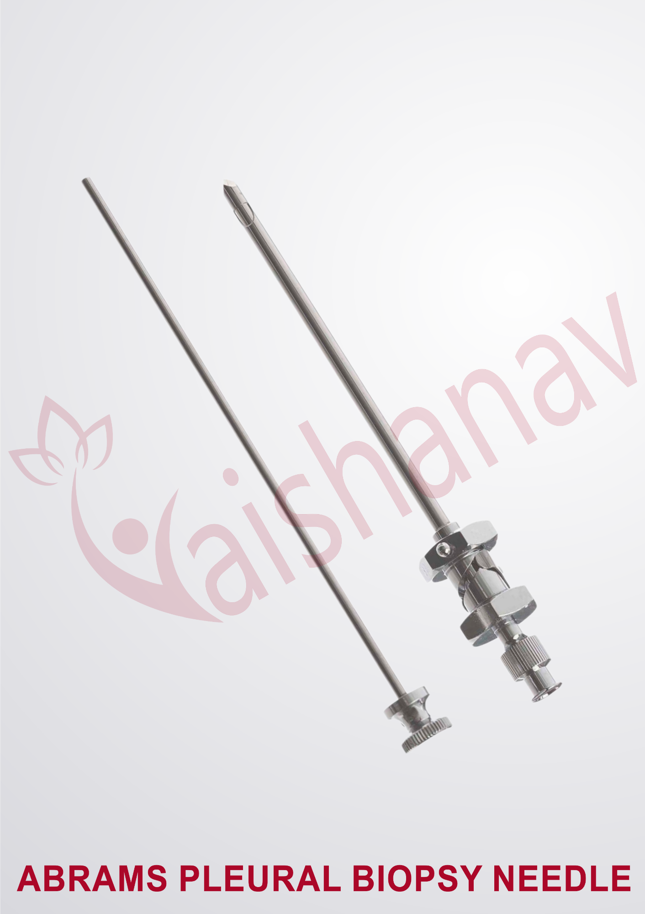
Types of biopsy needles

Slide 10
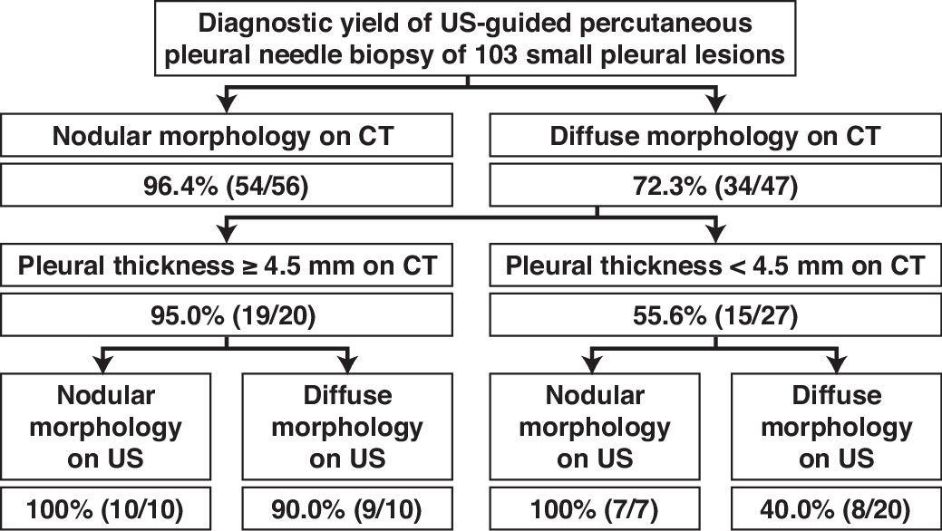
Performance

Slide 11
Medical thoracoscopy
A minimally invasive endoscopic procedure that allows for direct visualization and intervention within the pleural space using a thoracoscope.
It is performed under local anesthesia and conscious sedation by pulmonologists to diagnose and treat pleural conditions, such as undiagnosed pleural effusions, pleural thickening, complicated infections, and malignant effusions, often involving simultaneous biopsies or therapeutic procedures like pleurodesis.
Clin Chest Med. 2021 Dec;42(4):751-766

Slide 12
Equipment: A thin tube-like instrument called a thoracoscope, equipped with a camera, is passed through a small hole made between the ribs into the pleural space.
Visualization: The camera provides a real-time view of the pleura, diaphragm, and the outside of the lung on a video screen.
Working Instruments: Instruments like biopsy forceps, scissors, and electrocoagulation forceps are passed through the working channel of the thoracoscope to perform procedures

Slide 13
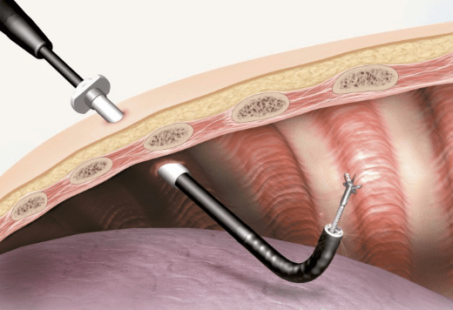
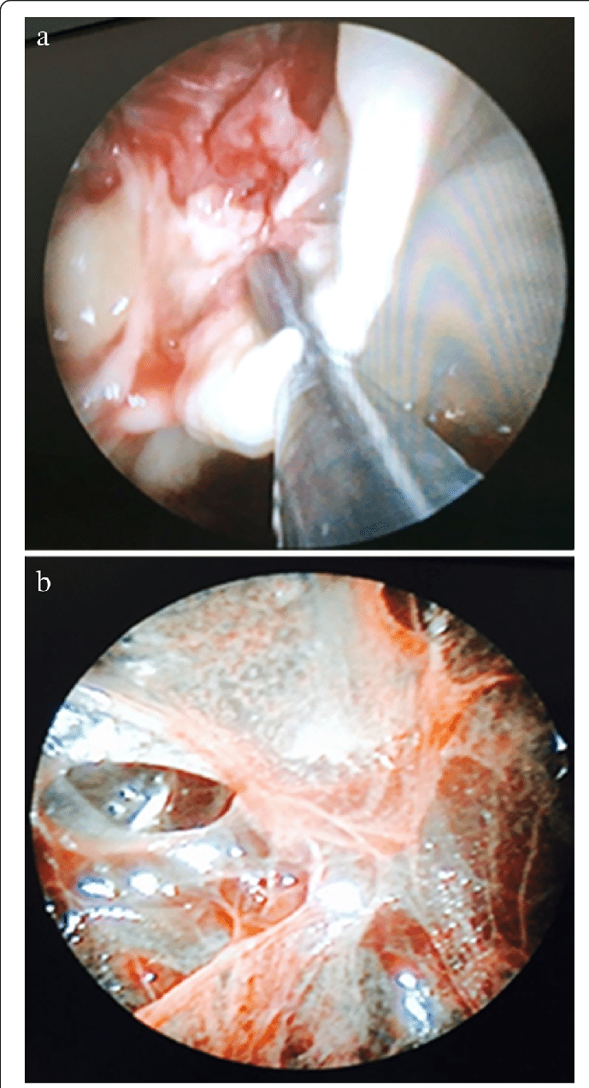
Pleuroscopy

Slide 14
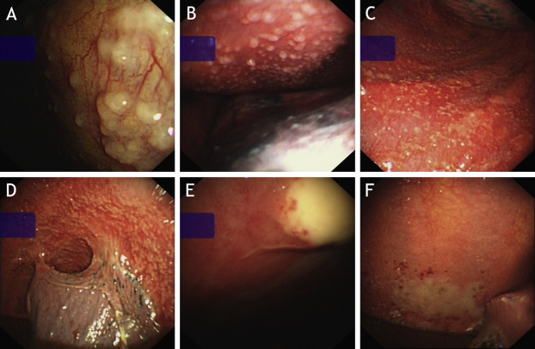
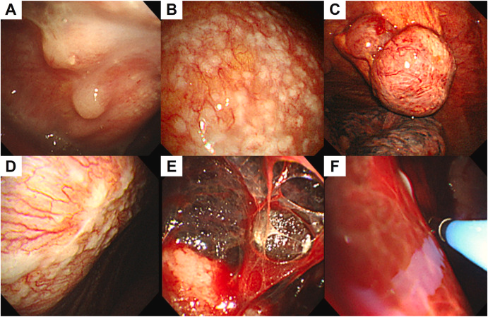
Pleuroscopy findings
TB
Malignancy

Slide 15
Advantages
Minimally Invasive: A single port of entry is used, making it less invasive than surgical thoracoscopy.
Simultaneous Diagnosis and Therapy: Both diagnostic and therapeutic procedures can be performed during the same session.
Effective Diagnosis: It provides direct visualization for diagnosing unknown pleural fluid, pleural thickening, and malignant or tuberculous diseases.
Therapeutic Applications: It is used to drain complicated pleural fluid collections, divide septations in pleural infections, and perform pleurodesis to manage recurrent malignant effusions.

Slide 16
Complications
Pain: Mild chest pain can occur after the procedure.
Pneumothorax: Air leakage from the lung into the pleural space, causing the lung to collapse.
Bleeding: Can occur at incision or biopsy sites.
Infection: Infection in the pleural space is a possibility.
Pulmonary Edema: Swelling in the lungs, leading to breathlessness.
Allergic Reactions: Possible reactions to sedatives, equipment, or materials used during the procedure

Slide 17
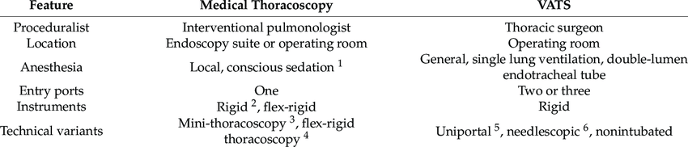
Medical thoracoscopy Vs Video assisted thoracoscopy

Slide 18
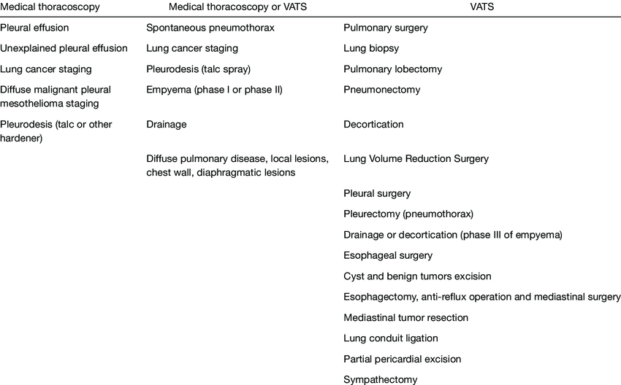
Indications of VATS and/ or MT

Slide 19
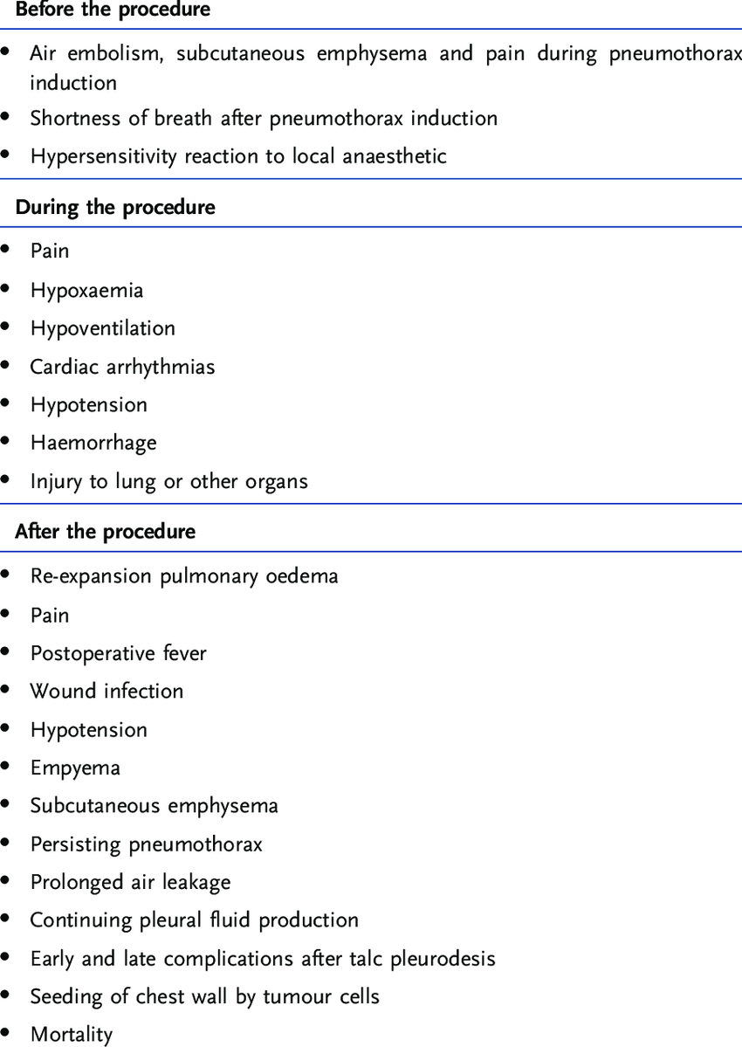
Pleuroscopy and VATS complications

Slide 20
Pleural fluid management
Acute
Recurrent collection
Loculated and/or chronic effusions

Slide 21
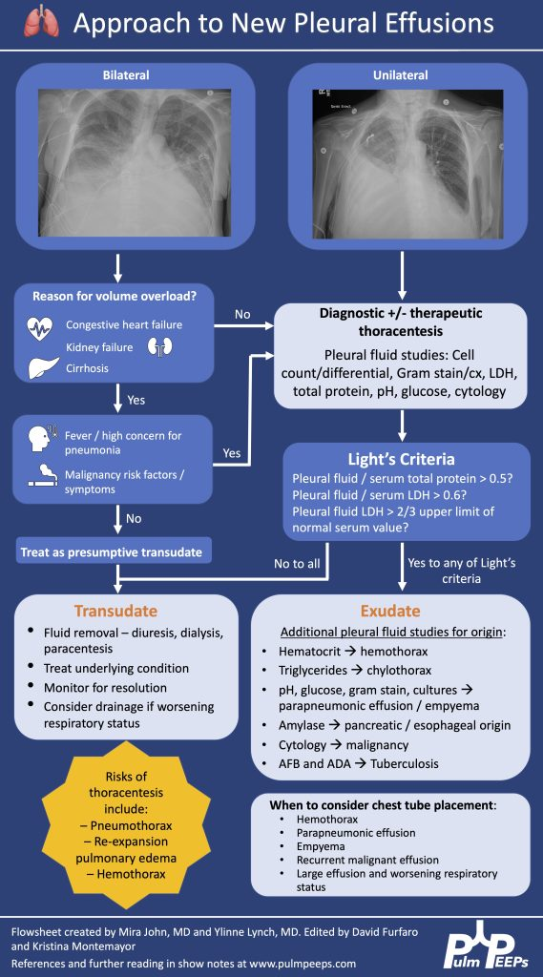

Slide 22
Recurrent effusions
Consider
Pleurodesis
Talc- slurry or poudrage
Doxycycline, bleomycin
VATS partial pleurectomy
Indwelling pleural catheters
IPCs provide the option of managing recurrent pleural effusion in the home setting and insertion is done as a day case procedure
Compared to chest tube and talc pleurodesis, the question to ask is which is better when it comes to improving dyspnoea scores and quality of life. The TIME 2 trial looked at both these entities the primary outcome being the difference in the degree of dyspnoea at 42 days between the two groups. No significant difference. Any as primary option – BTS guideline 2023
Eur Respir J. 2018;52:1800349
JAMA. 2012;307:2383–9.
Thorax. 2023;78:1–42.

Slide 23
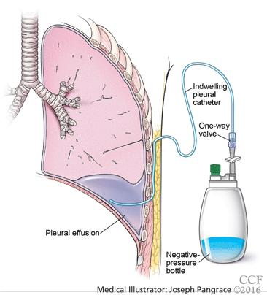

Slide 24
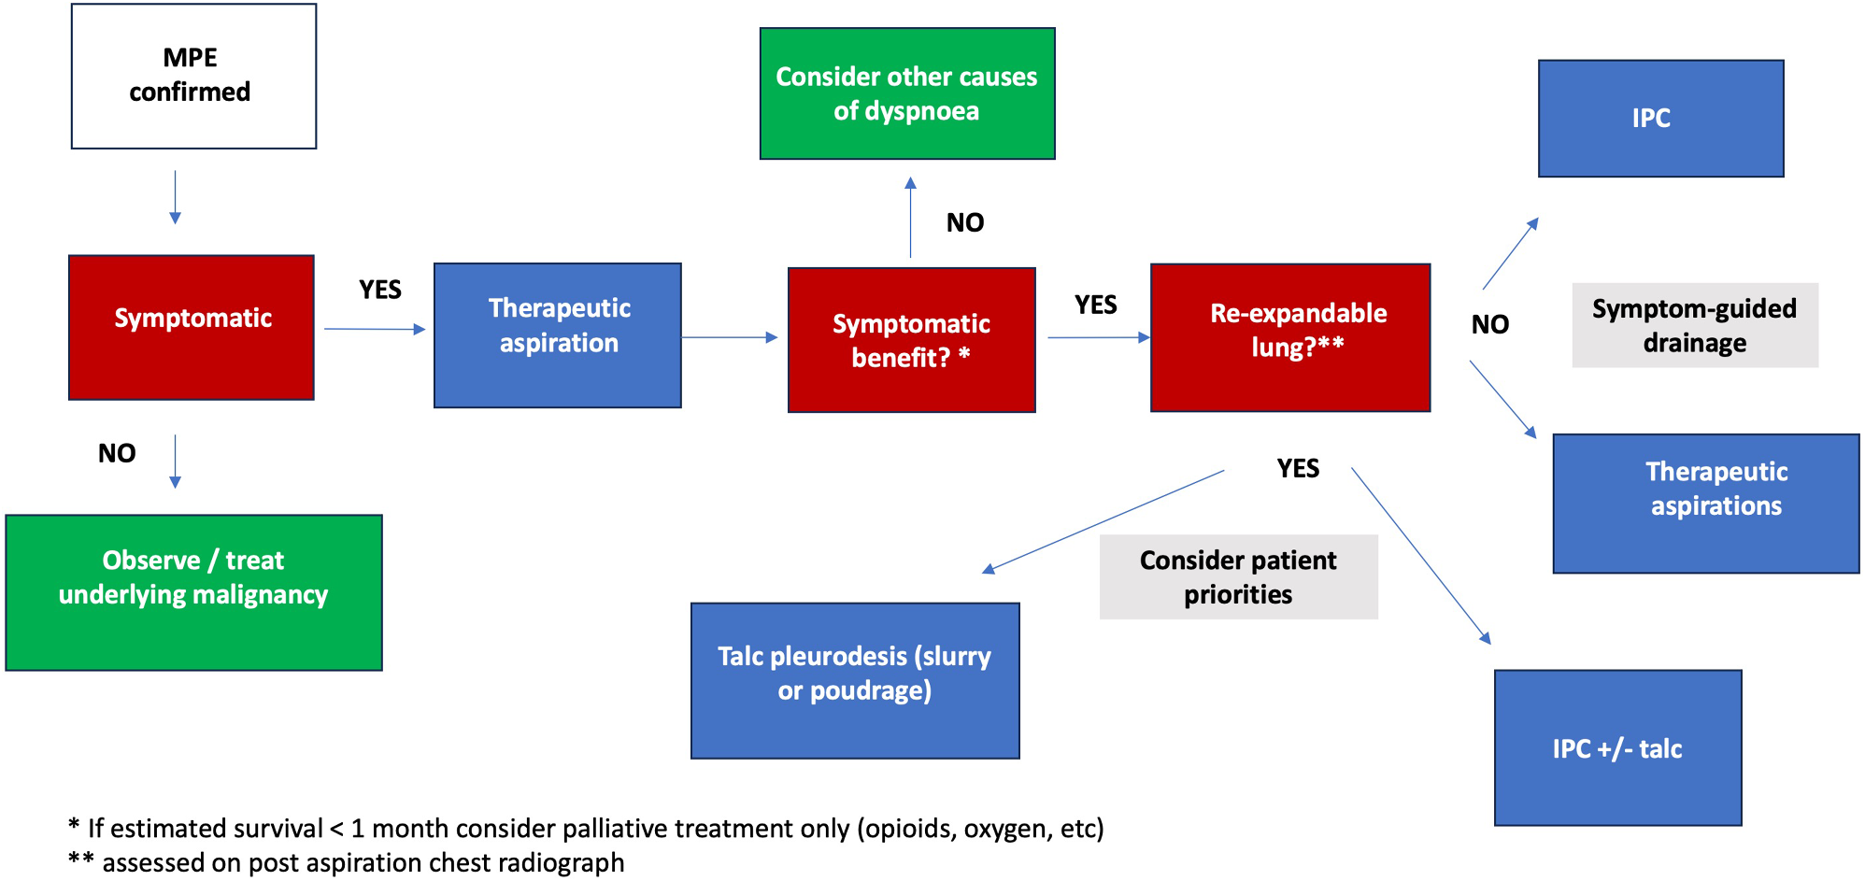
Management of Malignant pleural effusion
Respir Res 25, 47 (2024).

Slide 25
Loculated effusions - Fibrinolysis vs Pleuroscopy Vs VATS
Initial consideration to chest drain insertion – small bore 12/14f vs surgical intervention
Fibrinolysis to be considered if residual fluid – Tpa and DNAase (or saline)
VATS access should be considered over thoracotomy for adults in the surgical management of pleural infection.
When selecting a surgical access for the treatment of pleural infection in adults, it is important to ensure the technique can facilitate optimal clearance of infected material and achieve lung re-expansion where appropriate.
Extent of surgery should be tailored according to patient and empyema stage when the lung is not completely trapped (drainage vs debridement)
Decortication should be a decision that is individualised to the patient with a trapped lung based on assessment of patient fitness and empyema stage.
British Thoracic Society Guideline for pleural disease 2023 .https://doi.org/10.1136/thorax-2023-220304

Slide 26
Summary
IP has lots to offer in the management of pleural diseases
Advantage – minimal access intervention with proven good outcomes
Challenge – skill acquisition, cost of equipment and procedures
Opportunity – favorable outcomes and relatively short hospitalisation

Slide 27
Thanks
Discussion

